Slide 1
WATER POLLUTION
Main sources of water pollution
Industrial waste
Domestic waste
Agricultural runoff
Arsenic contamination
Climate change impacts
Sewage Discharge
Waste Dumping (Solid Waste)
River Dumping
Oil Pollution

Slide 2
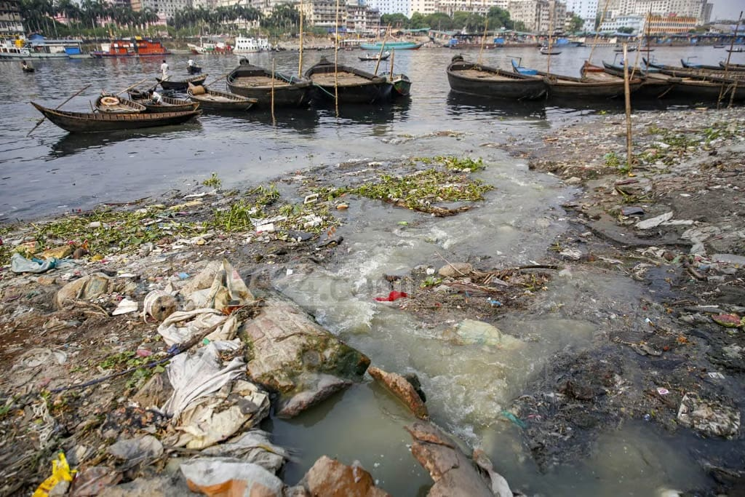
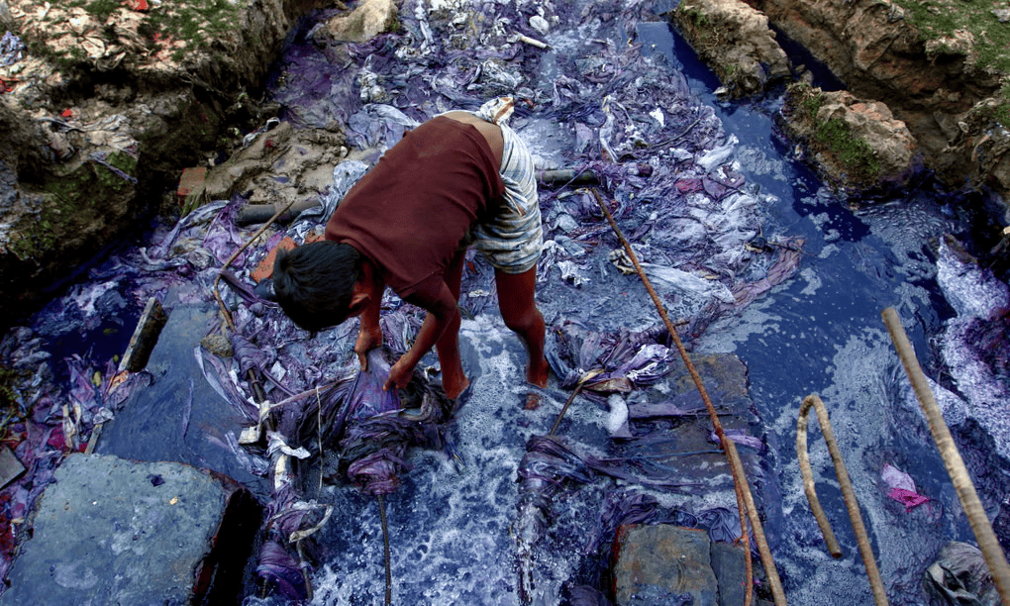
Buriganga River Pollution
21,600 m³/day toxic tannery waste flows into the river.
4,500 tons/day of Dhaka’s solid waste enters the Buriganga.
Unsafe ammonia levels at Chandnighat & Fatullah show sewage and animal waste pollution.
“Forever Chemicals” (PFAS) Contamination
Very high PFAS levels found near garment factories in Dhaka.
Some samples were hundreds to thousands of times above EU/US safety limits.
Indicates severe chemical pollution and long-term health risks.

